Slide 1
CS 542 Link state algorithm simulator
Submitted by
Nithin Rajeev
A20356359

Slide 2
Link state algorithm
Every node creates a map of the connectivity of the network.
Graph shows which nodes are connected to which other node in the network.
Each node calculates the next best logical path to the destination.
LSP – Link state Packet is a small packet containing the routing information that is sent between the routers.

Slide 3
Link state routing
Each router is responsible for meeting its neighbors and learning their names.
Uses LSP to publish their link information.
Each router calculates the entire shortest path tree.
Uses Dijkstra’s algorithm to calculate the shortest path.

Slide 4
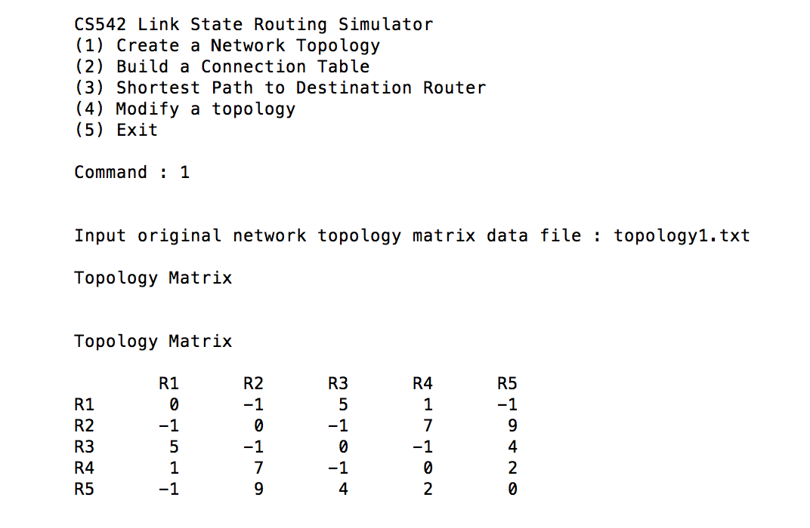
Creating a network topology

Slide 5
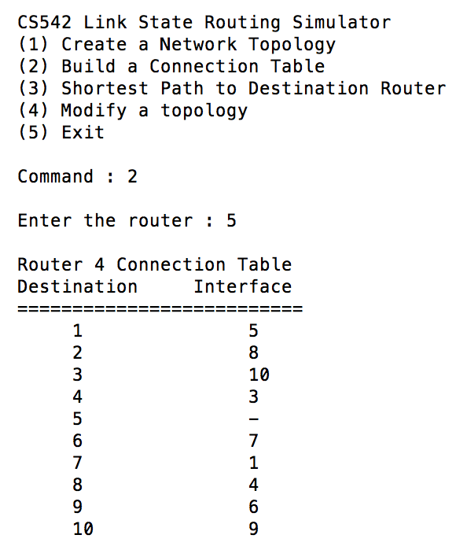
Displaying a connection table

Slide 6
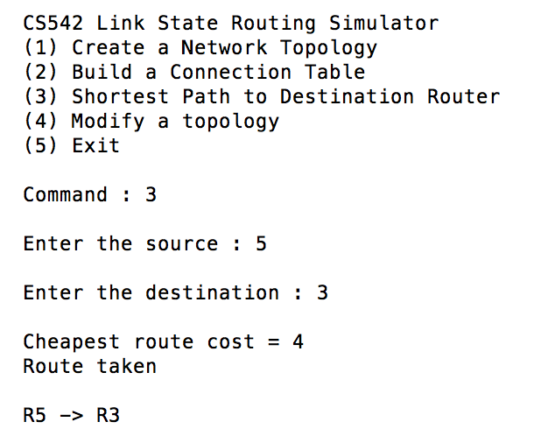
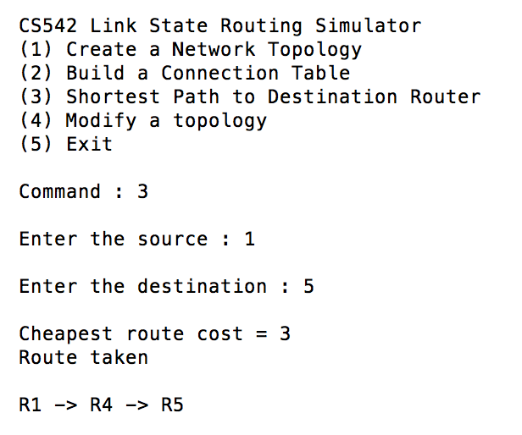
Displaying the route

Slide 7
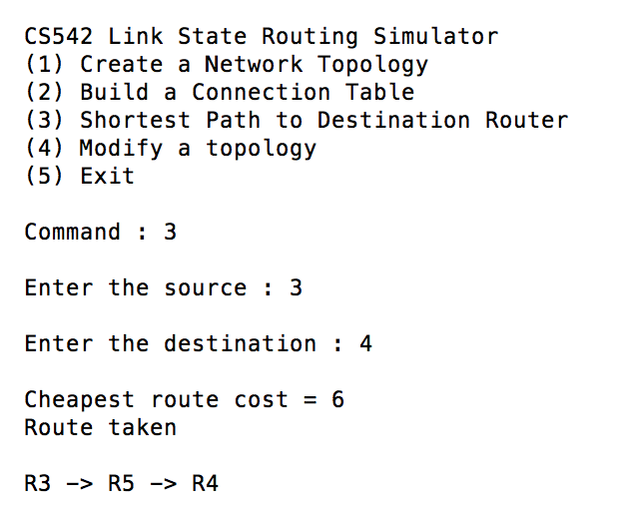
… continued

Slide 8
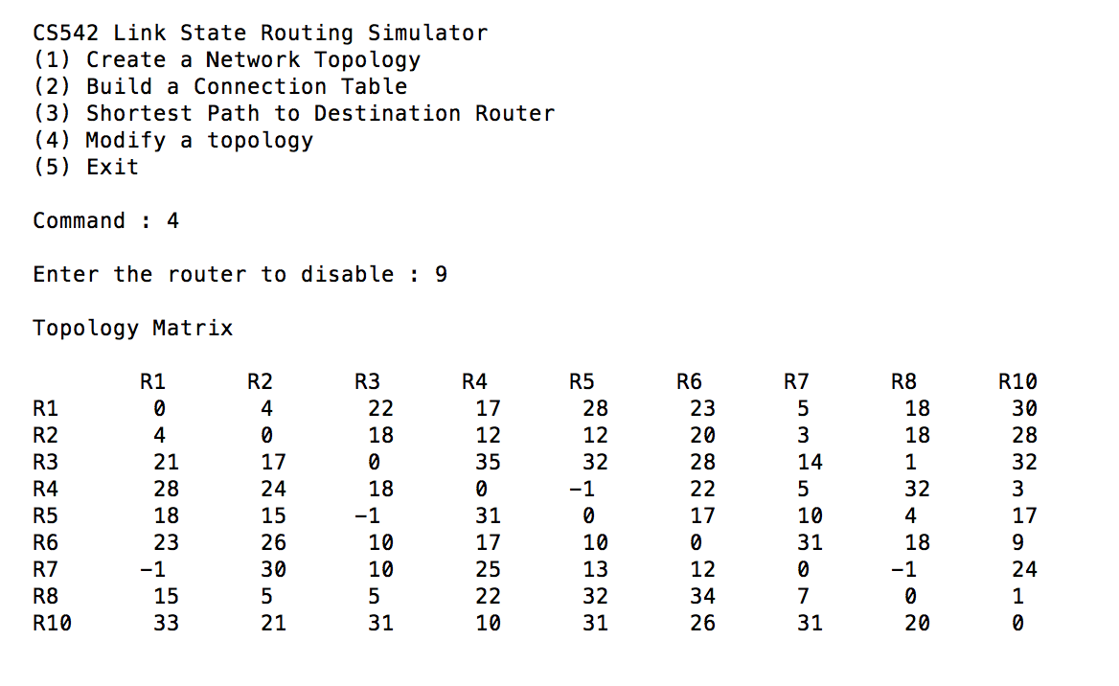
Modifying a topology

Slide 9
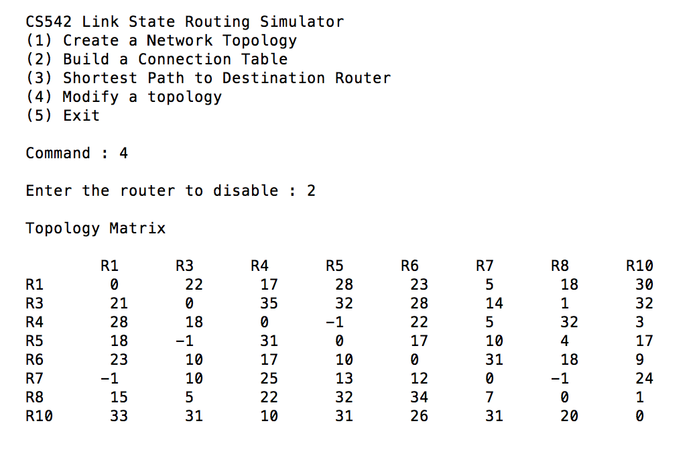
Modifying a topology

Slide 10
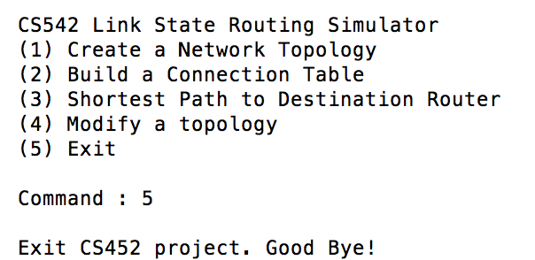
Exit the program

Slide 11
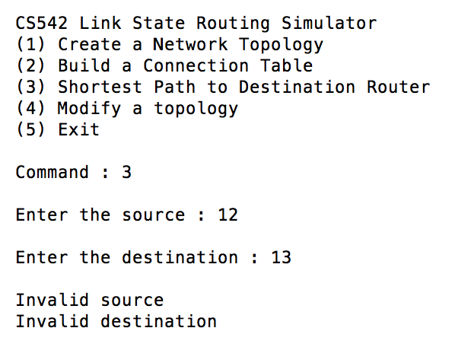
Invalid source and destination

Slide 12
Thank YOU

